Slide 2



Slide 3


Slide 4


Slide 5


Slide 6
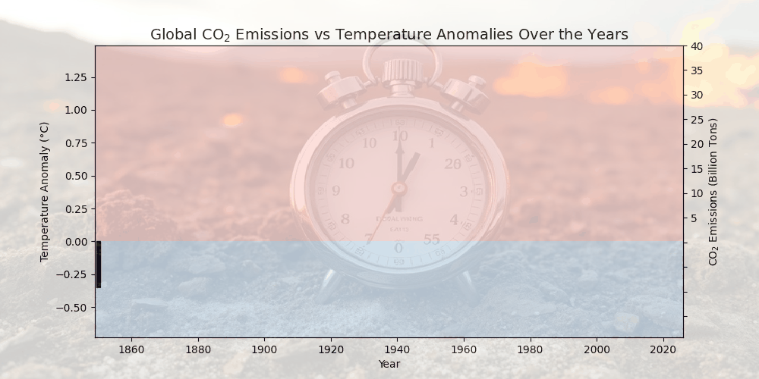

Slide 7

Is Australia on Track with Emissions?
Small size, but large impact
Though just 0.3% of global population
Ranks among the top per-capita carbon emitters
Global leader in many fields and economy

Slide 8

Are we on track on Paris targets?
2030:
43% reduction in GHG emissions (from 2005 baseline)
82% renewable electricity generation
2050:
Net Zero GHG Emissions
Net Emission = Gross Emissions (from human activity) – Removals (e.g., carbon offsets, afforestation, carbon capture)

Slide 9
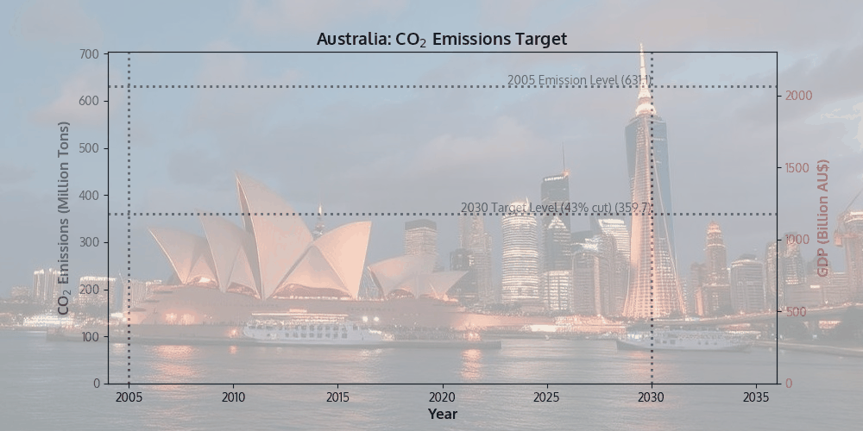

Slide 10
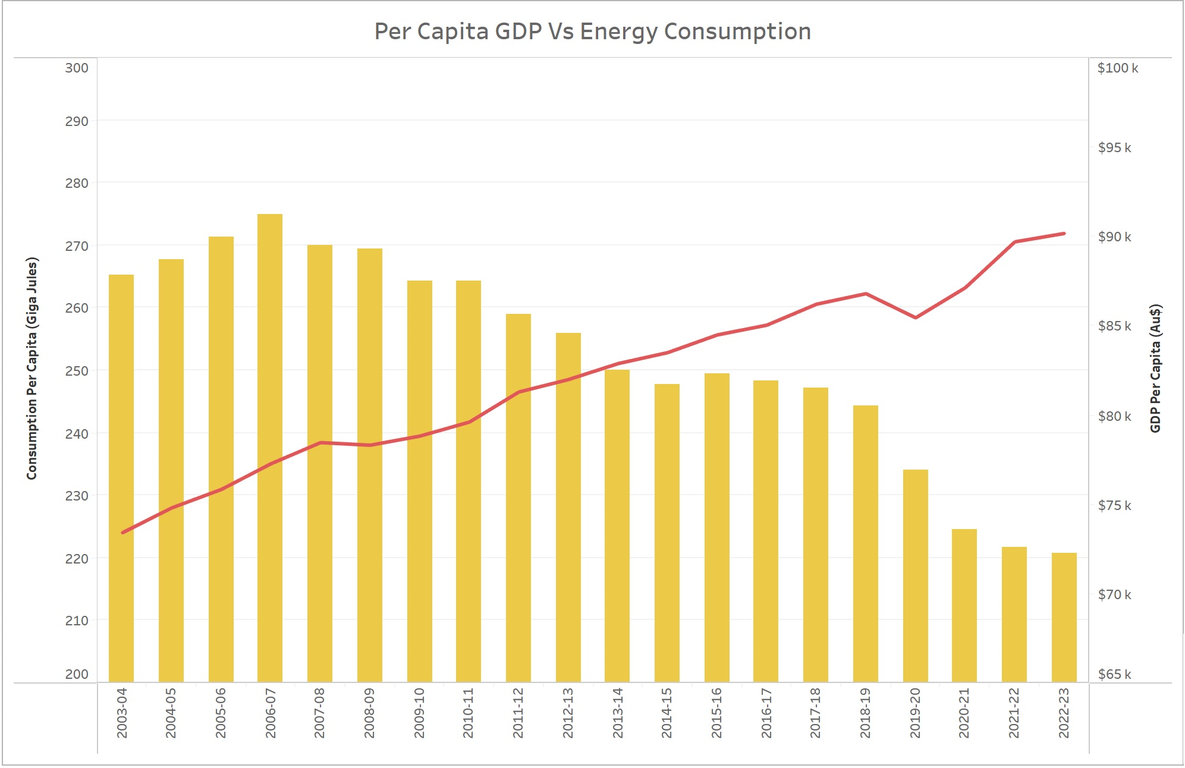

Slide 11
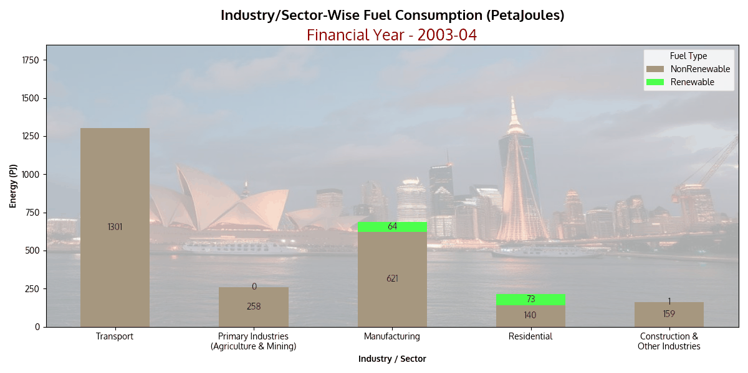

Slide 12
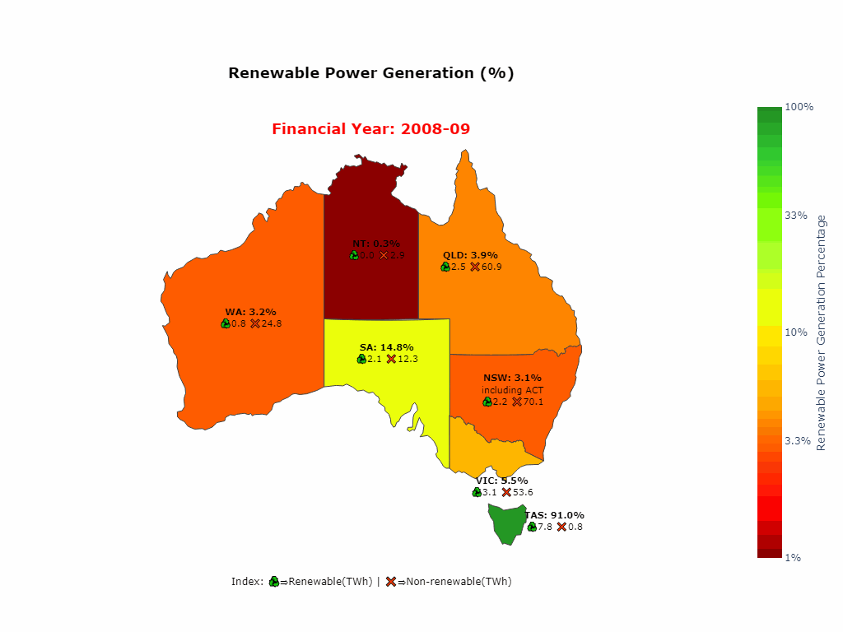

Slide 13
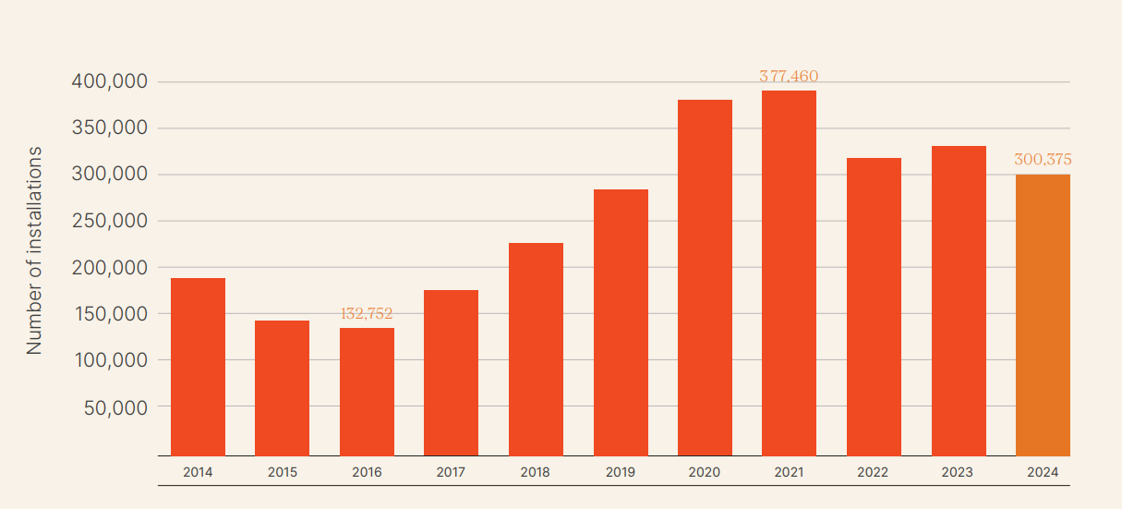
In November 2024, rooftop PV celebrated a significant milestone, surpassing four million installations and a cumulative total capacity of 25.5 GW. Australia continues to be a leading nation in per capita electricity generation from solar. In 2023 it ranked first ahead of United Arab Emirates and the Netherlands with 1,774 kWh of electricity generation from solar power per person
More than 1 in 3 homes in South Australia have rooftop solar—proof that individuals can lead change.
National number of Rooftop Solar Installations by year

Slide 14
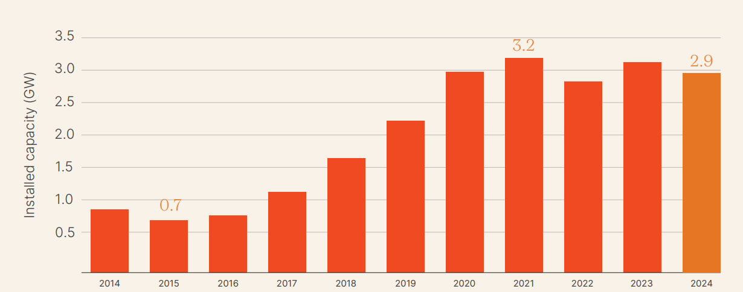
National installed rooftop PV capacity (GW), by year

Slide 15
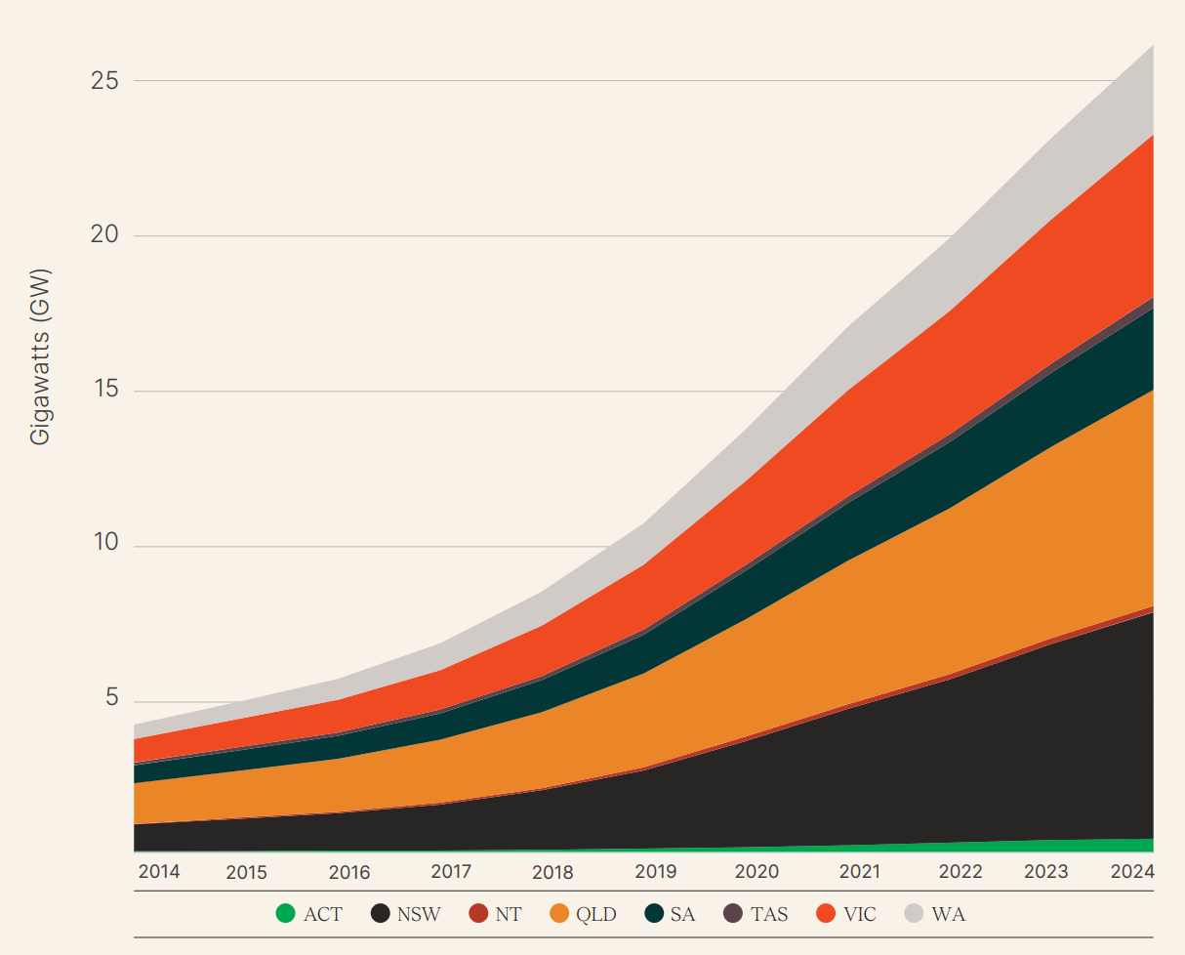
Cumulative Annual Capacity of Australian States’ Rooftop PV

Slide 16
Overall rating: Insufficient (< 3°C World)
Policies and action against modelled domestic pathways: Insufficient
NDC target against modelled domestic pathways: Insufficient
NDC target against fair contribution to global climate efforts: Insufficient
Climate finance: Critically insufficient
If we continue on our current course, we overshoot the target. New policies must be bolder.
Source: https://climateactiontracker.org/countries/australia/

Slide 17
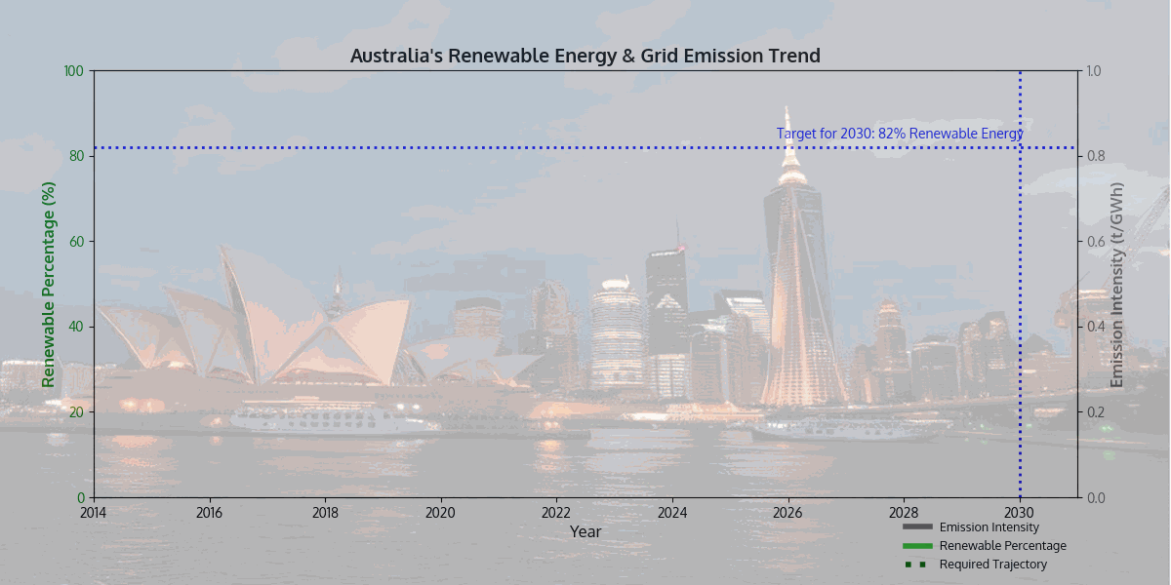

Slide 18
